Slide 1
Introduction to Computer Graphics with WebGL
Ed Angel
Professor Emeritus of Computer Science
Founding Director, Arts, Research, Technology and Science Laboratory
University of New Mexico
Angel and Shreiner: Interactive Computer Graphics 7E © Addison-Wesley 2015

Slide 2
Computing the Mandelbrot Set
Ed Angel
Professor Emeritus of Computer Science
University of New Mexico
Angel and Shreiner: Interactive Computer Graphics 7E © Addison-Wesley 2015

Slide 3
Objectives
Introduce the most famous fractal object
  more about fractal curves and surfaces later
Imaging calculation
  Must compute value for each pixel on display
  Shows power of fragment processing
Angel and Shreiner: Interactive Computer Graphics 7E © Addison-Wesley 2015

Slide 4
Sierpinski Gasket
Rule based:
Repeat n times. As n →∞
Area→0
Perimeter →∞
Not a normal geometric object
More about fractal curves and surfaces later
Angel and Shreiner: Interactive Computer Graphics 7E © Addison-Wesley 2015

Slide 5
Complex Arithmetic
Complex number defined by two scalars
  z = x + jy
  j² = -1
Addition and Subtraction
  z₁+z₂ = x₁ + x₂ +j(y₁+y₂)
  z₁*z₂ = x₁*x₂-y₁*y₂ + j(x₁*y₂+x₂*y₁)
Magnitude
  |z|² = x² + y²
Angel and Shreiner: Interactive Computer Graphics 7E © Addison-Wesley 2015

Slide 6
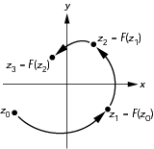
Iteration in the Complex Plane
Angel and Shreiner: Interactive Computer Graphics 7E © Addison-Wesley 2015

Slide 7
Mandelbrot Set
iterate on z_{k+1}=z_{k}²+c
with z₀ = 0 + j0
Two cases as k →∞
|z_{k} |→∞
|z_{k} | remains finite
If for a given c, |z_{k} | remains finite, then c belongs to the Mandelbrot set
Angel and Shreiner: Interactive Computer Graphics 7E © Addison-Wesley 2015

Slide 8
Computing the Mandelbrot Set
Pick a rectangular region
Map each pixel to a value in this region
Do an iterative calculation for each pixel
  If magnitude is greater than 2, we know sequence will diverge and point does not belong to the set
  Stop after a fixed number of iterations
  Points with small magnitudes should be in set
  Color each point based on its magnitude
Angel and Shreiner: Interactive Computer Graphics 7E © Addison-Wesley 2015

Slide 9

Mandelbrot Set
Angel and Shreiner: Interactive Computer Graphics 7E © Addison-Wesley 2015

Slide 10
Exploring the Mandelbrot Set
Most interesting parts are centered near (-0.5, 0.0)
Really interesting parts are where we are uncertain if points are in or out of the set
Repeated magnification these regions reveals complex and beautiful patterns
We use color maps to enhance the detail
Angel and Shreiner: Interactive Computer Graphics 7E © Addison-Wesley 2015

Slide 11
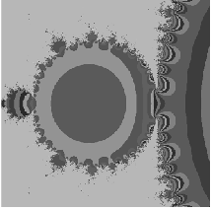
Mandelbrot Set
Angel and Shreiner: Interactive Computer Graphics 7E © Addison-Wesley 2015

Slide 12
Computing in the JS File I
Form a texture map of the set and map to a rectangle
var height = 0.5;
// size of window in complex plane
var width = 0.5;var cx = -0.5;
// center of window in complex plane
var cy = 0.5;var max = 100;
// number of interations per point
var n = 512;
var m =512;
var texImage = new Uint8Array(4*n*m);
Angel and Shreiner: Interactive Computer Graphics 7E © Addison-Wesley 2015

Slide 13
Computing in JS File II
for ( var i = 0; i < n; i++ )
for ( var j = 0; j < m; j++ ) {
var x = i * ( width / (n - 1) ) + cx - width / 2;
var y = j * ( height / ( m - 1 ) ) + cy - height / 2;
var c = [ 0.0, 0.0 ];
var p = [ x, y ];
for ( var k = 0; k < max; k++ ) {
// compute c = c^2 + p
c = [c[0]*c[0]-c[1]*c[1], 2*c[0]*c[1]];
c = [c[0]+p[0], c[1]+p[1]];
v = c[0]*c[0]+c[1]*c[1];
if ( v > 4.0 ) break; /* assume not in set if mag > 2 */
}
Angel and Shreiner: Interactive Computer Graphics 7E © Addison-Wesley 2015

Slide 14
Computing in JS File III
// assign gray level to point based on its magnitude */
if ( v > 1.0 ) v = 1.0; /* clamp if > 1 */
texImage[4*i*m+4*j] = 255*v;
texImage[4*i*m+4*j+1] =
255*( 0.5* (Math.sin( v*Math.PI/180 ) + 1.0));
texImage[4*i*m+4*j+2] = 255*(1.0 - v);
texImage[4*i*m+4*j+3] = 255;
}
Set up two triangles to define a rectangle
Set up texture object with the set as data
Render the triangles
Angel and Shreiner: Interactive Computer Graphics 7E © Addison-Wesley 2015

Slide 15
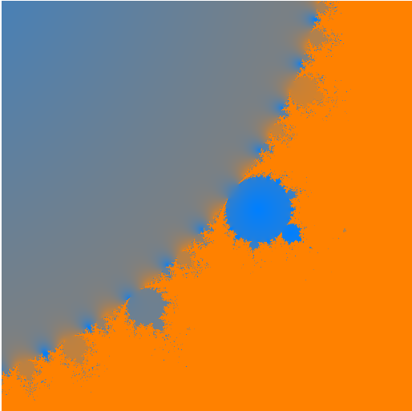
Example
Angel and Shreiner: Interactive Computer Graphics 7E © Addison-Wesley 2015

Slide 16
Fragment Shader
Our first implementation is incredibly inefficient and makes no use of the power of the fragment shader
Note the calculation is “embarrassingly parallel”
  computation for the color of each fragment is completely independent
  Why not have each fragment compute membership for itself?
  Each fragment would then determine its own color
Angel and Shreiner: Interactive Computer Graphics 7E © Addison-Wesley 2015

Slide 17
Interactive Program
JS file sends window parameters obtained from sliders to the fragment shader as uniforms
Only geometry is a rectangle
No need for a texture map since shader will work on individual pixels
Angel and Shreiner: Interactive Computer Graphics 7E © Addison-Wesley 2015

Slide 18
Fragment Shader I
precision mediump float;
uniform float cx;
uniform float cy;
uniform float scale;
float height;
float width;
void main() {
const int max = 100; /* number of iterations per point */
const float PI = 3.14159;
float n = 1000.0;
float m = 1000.0;
Angel and Shreiner: Interactive Computer Graphics 7E © Addison-Wesley 2015

Slide 19
Fragment Shader II
float v;
float x = gl_FragCoord.x /(n*scale) + cx - 1.0 / (2.0*scale);
float y = gl_FragCoord.y/(m*scale) + cy - 1.0 / (2.0*scale);
float ax=0.0, ay=0.0;
float bx, by;
for ( int k = 0; k < max; k++ ) {
// compute c = c^2 + p
bx = ax*ax-ay*ay;
by = 2.0*ax*ay;
ax = bx+x;
ay = by+y;
v = ax*ax+ay*ay;
if ( v > 4.0 ) break; // assume not in set if mag > 2
}
Angel and Shreiner: Interactive Computer Graphics 7E © Addison-Wesley 2015

Slide 20
Fragment Shader
// assign gray level to point based on its magnitude //
// clamp if > 1
v = min(v, 1.0);
gl_FragColor.r = v;
gl_FragColor.g = 0.5* sin( 3.0*PI*v) + 1.0;
gl_FragColor.b = 1.0-v;
gl_FragColor.b = 0.5* cos( 19.0*PI*v) + 1.0;
gl_FragColor.a = 1.0;
}
Angel and Shreiner: Interactive Computer Graphics 7E © Addison-Wesley 2015

Slide 21
Analysis
This implementation will use as many fragment processors as are available concurrently
Note that if an iteration ends early, the GPU will use that processor to work on another fragment
Note also the absence of loops over x and y
Still not using the full parallelism since we are really computing a luminance image
Angel and Shreiner: Interactive Computer Graphics 7E © Addison-Wesley 2015

